Slide 1

Dynamics CRM Online 2016 Customer Service features

Slide 2

Mitch Milam
Dynamics CRM Architect
Independent consultant and trainer
Ten-Time Dynamics CRM MVP
mitch@xrmcoaches.com
infinite–x.net
@mitchmilam

Slide 3
Agenda
Overview
Tour of the new navigation
Functionality discussion
Configuration
Demonstration

Slide 4
Overview

Slide 5
Access
New URL
https://[organization].crm.dynamics.com/engagementhub.aspx

Slide 6
New Design
Uses Dynamics CRM mobile layout engine
Changes must be synchronized before use
Pages do not scroll, only sections

Slide 7
Navigation

Slide 8
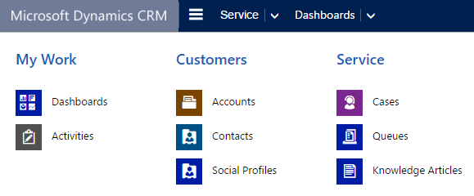
SiteMap

Slide 9
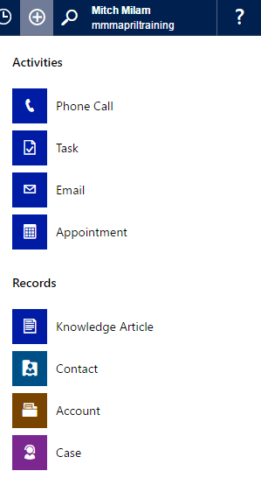
Quick Create

Slide 10
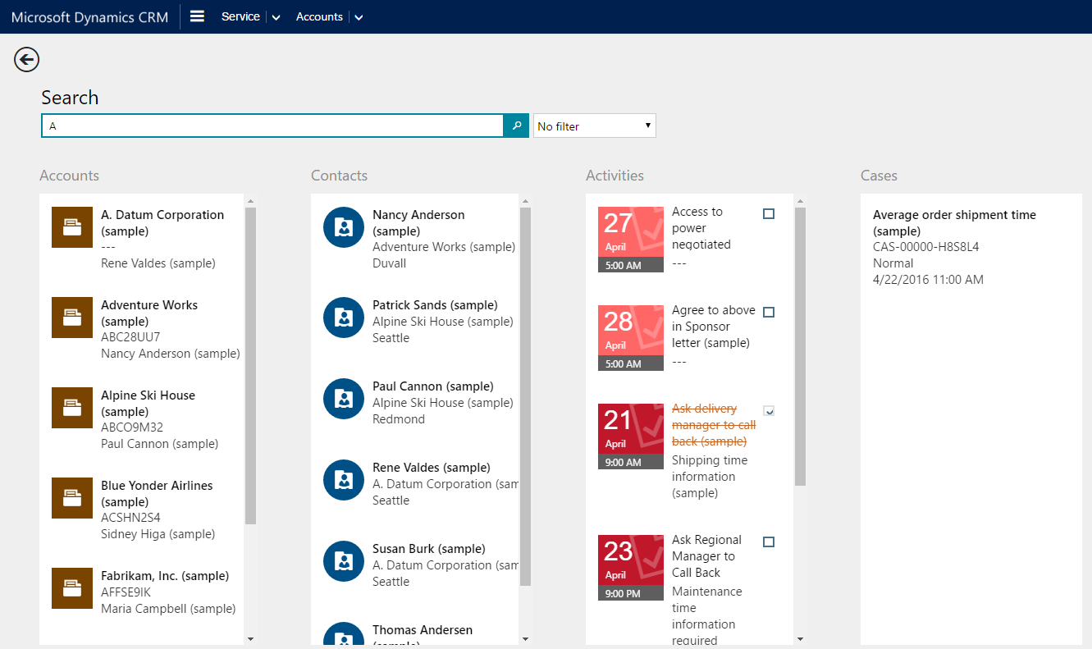
Searching

Slide 11
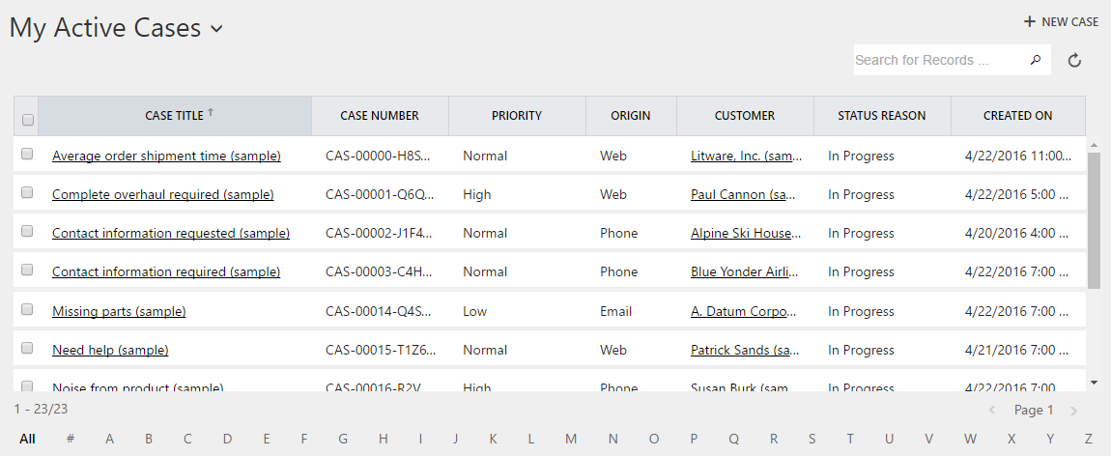
Views

Slide 12
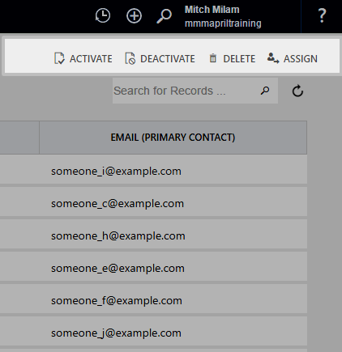
Command Bar

Slide 13
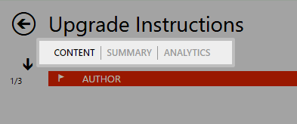
Horizontal Tabs

Slide 14
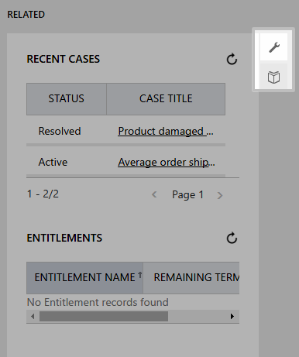
Vertical Tabs

Slide 15
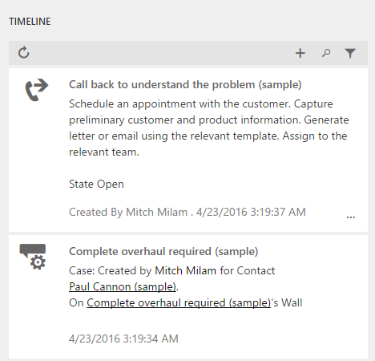
Interaction Wall (TimeLine)

Slide 16
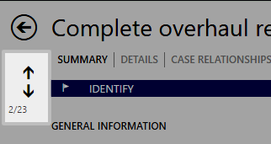
Record Navigation

Slide 17
Functionality

Slide 18
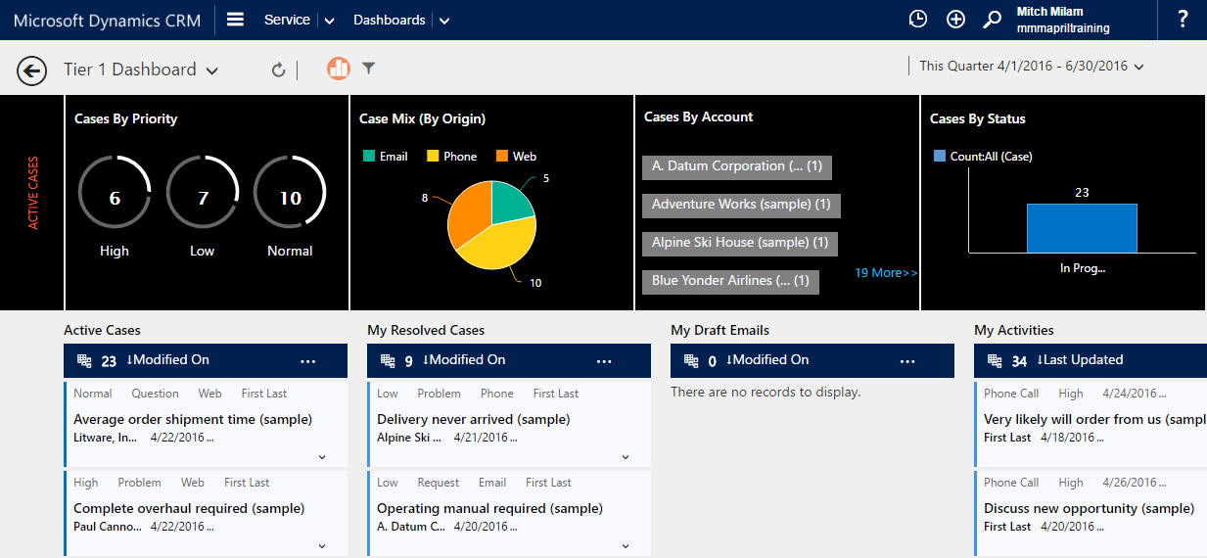
Dashboards

Slide 19
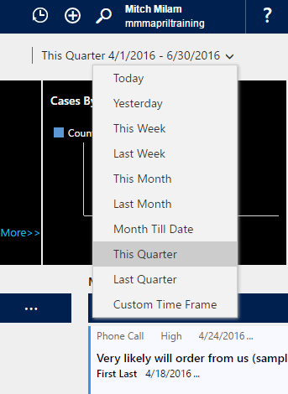
Dashboard Filtering

Slide 20
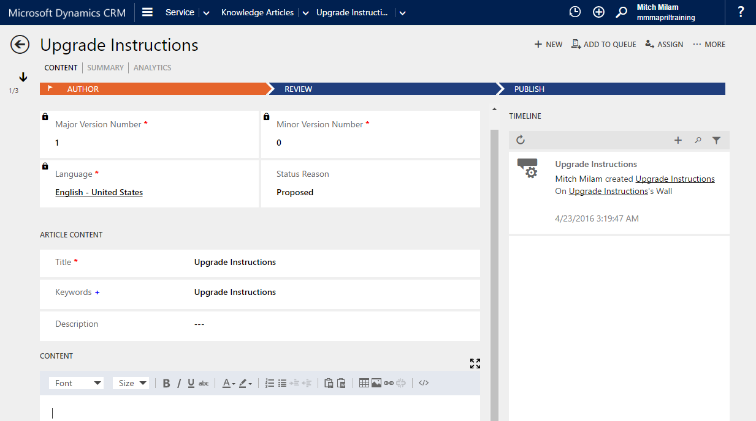
Knowledge Articles

Slide 21
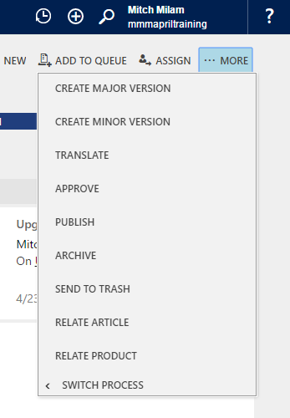
Knowledge Article Actions

Slide 22
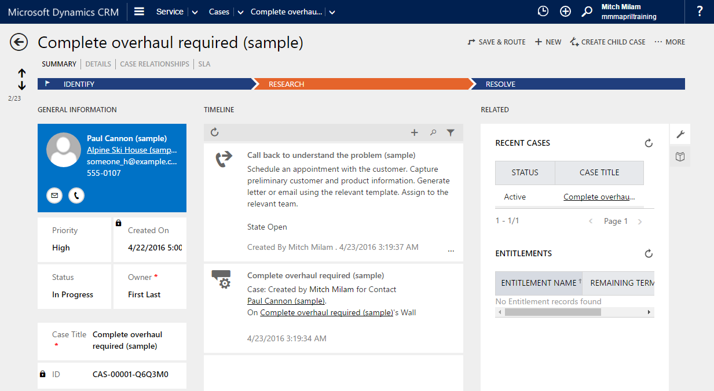
Cases

Slide 23
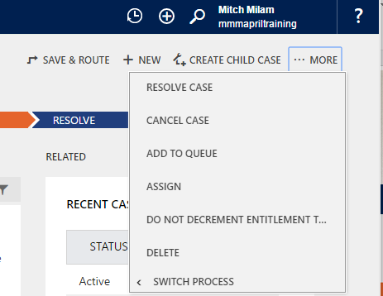
Case Actions

Slide 24
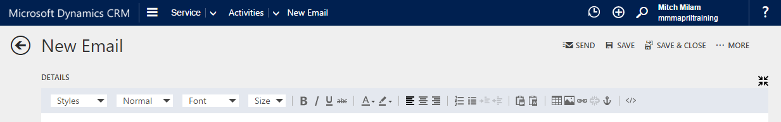
HTML Editor
Email message body
Knowledge Article content

Slide 25
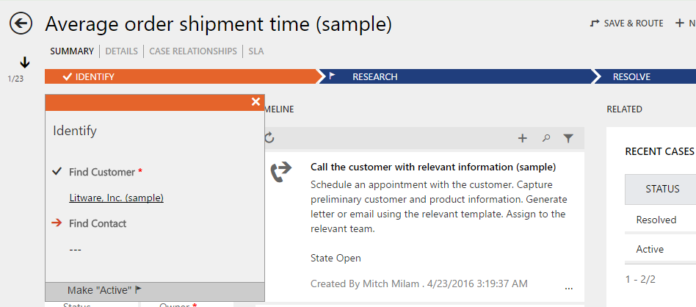
Business Process Flows

Slide 26
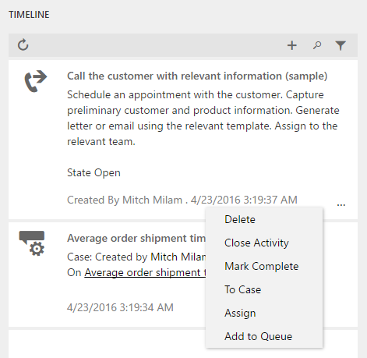
Timeline Quick Actions

Slide 27
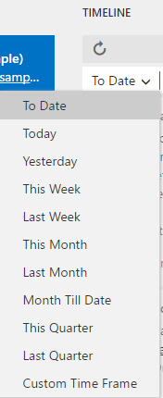
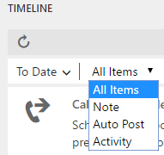
Timeline Filters

Slide 28
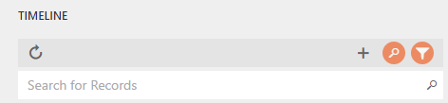
Timeline Search

Slide 29
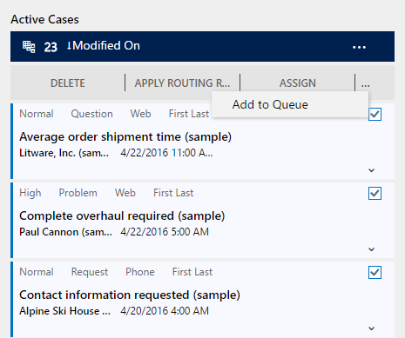
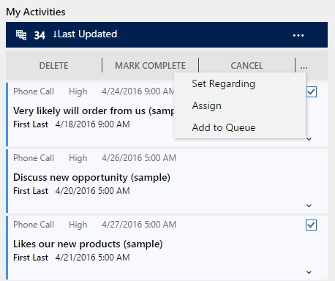
Bulk Actions

Slide 30
Configuration

Slide 31
Default Interactive Entities
Account
Contact
Case
Out-of-the-box activities (phone, task, email, appointment, and social activity)
Social Profile
Queue Item
Knowledge Article

Slide 32
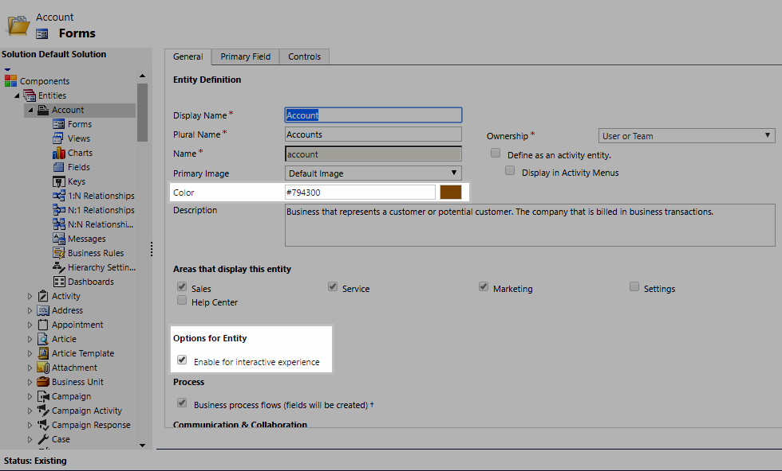
Enable Entity for Interactive Experience

Slide 33
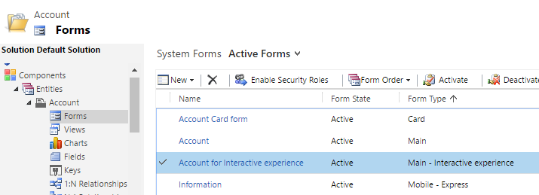
New Interactive Experience Form

Slide 34
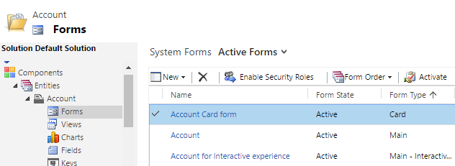
New Card Form

Slide 35
Demonstration

Slide 36
Questions?

Slide 37
Thank You

